Slide 1






S25' Training Sessions
mobile app
SESSION 3
#create_share_innovate

Slide 2





Table of contenet
Introduction to Object-Oriented Programming (OOP)
Operations on collections
Collections
S25' Training Sessions
Collection Methods

Slide 3



Recap
S25' Training Sessions
RECAP

Slide 4
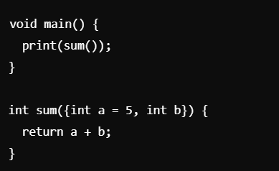
qUIZ
What will happen if you run this code?
S25' Training Sessions

Slide 5
qUIZ
S25' Training Sessions
Answer: Compilation error

Slide 6
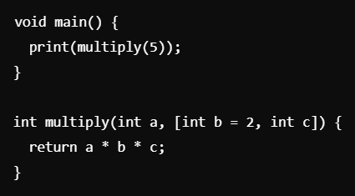
quiz
Issue in this function and fix it?
S25' Training Sessions

Slide 7
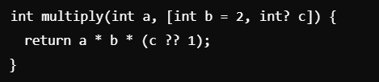
quiz
Answer: Provide a default value: [int c = 1],
or use a nullable type and null-aware operator:
S25' Training Sessions

Slide 8
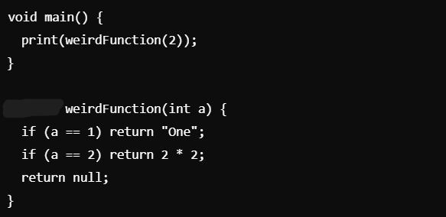
quiz
Return type of weirdFunction?
??
S25' Training Sessions
??

Slide 9
quiz
Answer:
dynamic
S25' Training Sessions
dynamic
dynamic

Slide 10
quiz
??
What does the following ternary operator do?
condition ? trueValue : falseValue
A) Executes the trueValue if the condition is true, otherwise executes falseValue
B) Always executes trueValue
C) Always executes falseValue
D) Only works inside a switch statement
S25' Training Sessions
??

Slide 11
quiz
??
Answer:
A) Executes the trueValue if the condition is true, otherwise executes falseValue
S25' Training Sessions
??

Slide 12
what is oop
A programming paradigm based on objects.
Uses real-world modeling for better code organization.
Focuses on data and behavior together.
concepts: Encapsulation, Abstraction, Inheritance, Polymorphism.
S25' Training Sessions

Slide 13
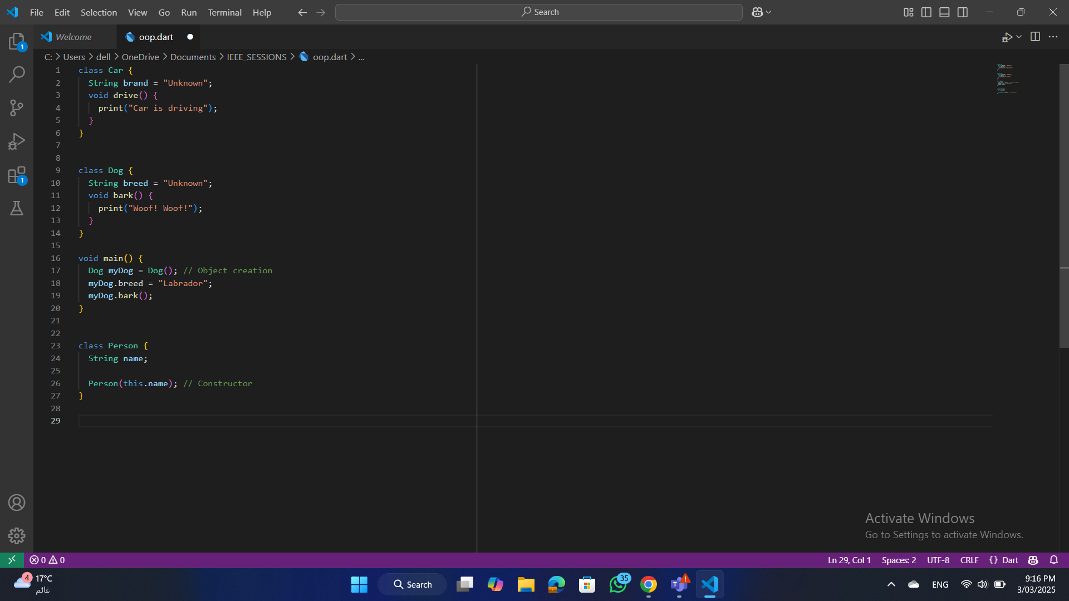
classes & objects
What are Classes and Objects?
S25' Training Sessions
Class: Blueprint for creating objects.
Object: An instance of a class.
Objects have state (attributes) and
behavior (methods).

Slide 14
Constructors
What are constructors
Special method used to initialize objects.
Called automatically when an object is created.
Name is the same as the class.
S25' Training Sessions

Slide 15
Types of constructores
Types of constructors:
S25' Training Sessions
Default Constructor (No parameters)
Parameterized Constructor (Accepts parameters)
Named Constructor.

Slide 16
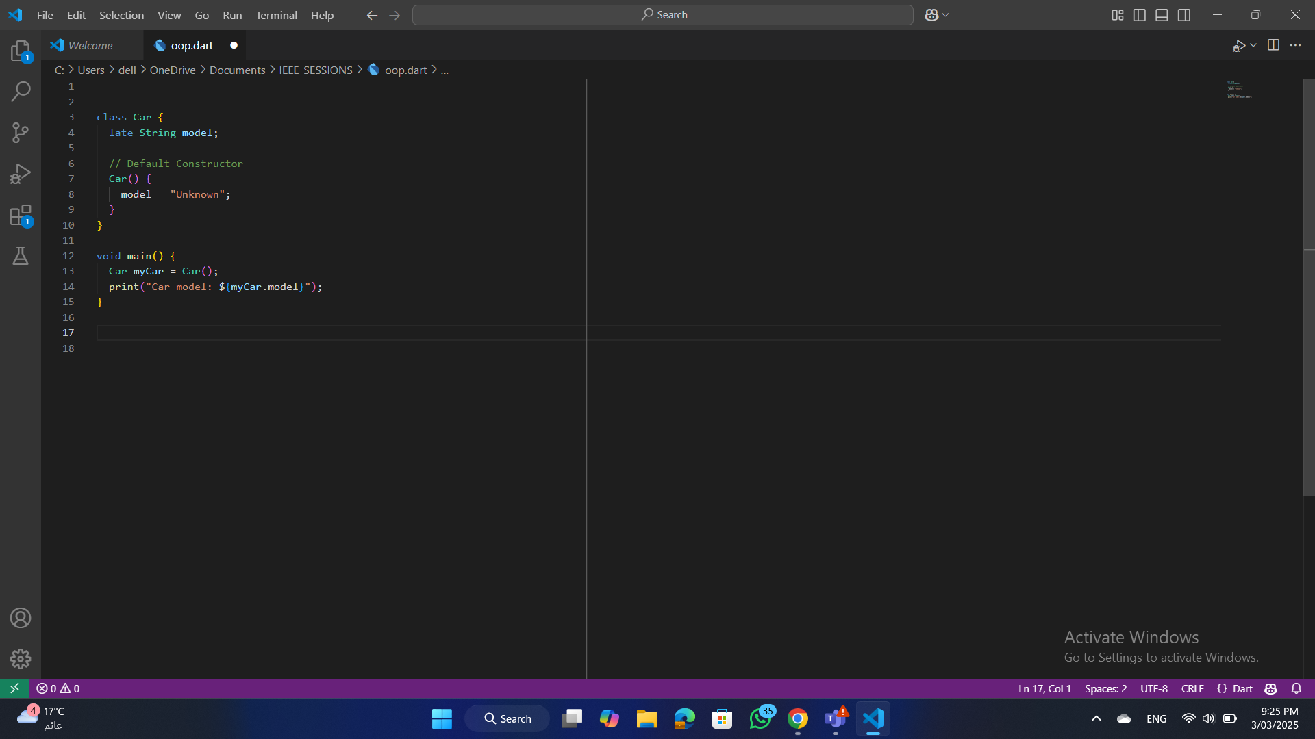
Default Constructor
Default Constructor (No parameters)
A constructor that takes no arguments.
Initializes objects with default values.
If no constructor is defined, Dart provides a default .
constructor automatically
S25' Training Sessions

Slide 17
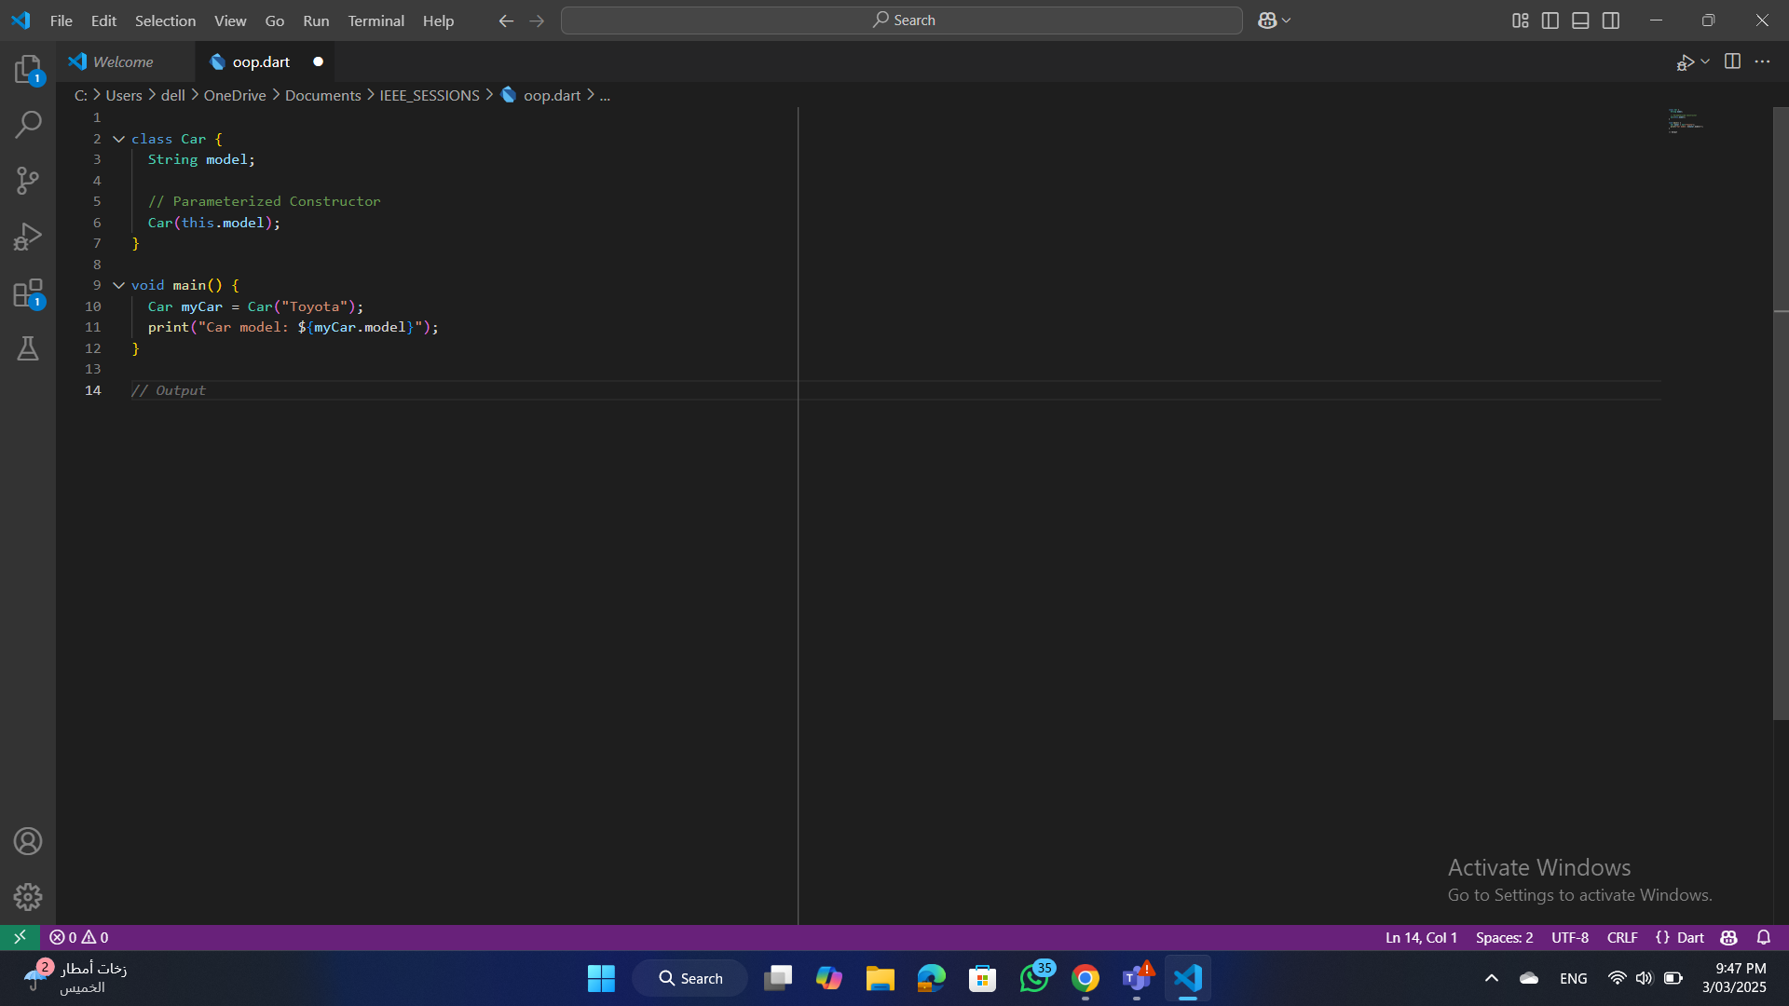
Parameterized Constructor
Parameterized Constructor (Accepts parameters)
A constructor that takes
arguments to initialize attributes.
Useful for assigning custom values
during object creation.
S25' Training Sessions

Slide 18
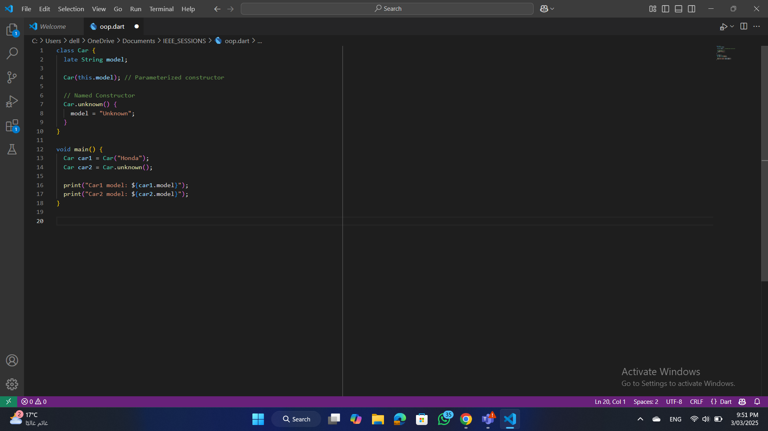
Named Constructor
Named Constructor
(Provides additional ways to create objects)
S25' Training Sessions

Slide 19
Exercise
Define a class Book with attributes title and author.
Create a constructor to initialize these attributes.
Instantiate an object using the constructor.
S25' Training Sessions

Slide 20
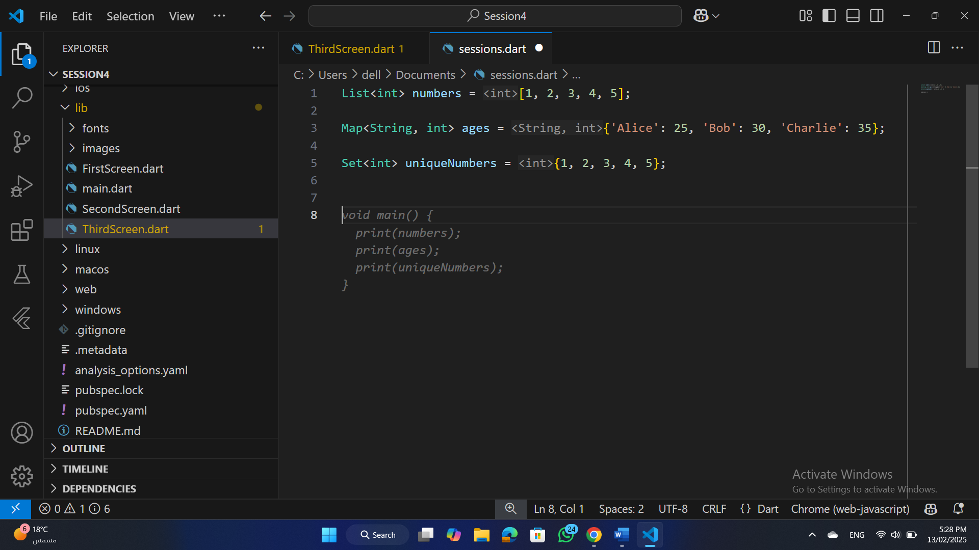
collections
List:
A list is an ordered collection of items.
S25' Training Sessions

Slide 21
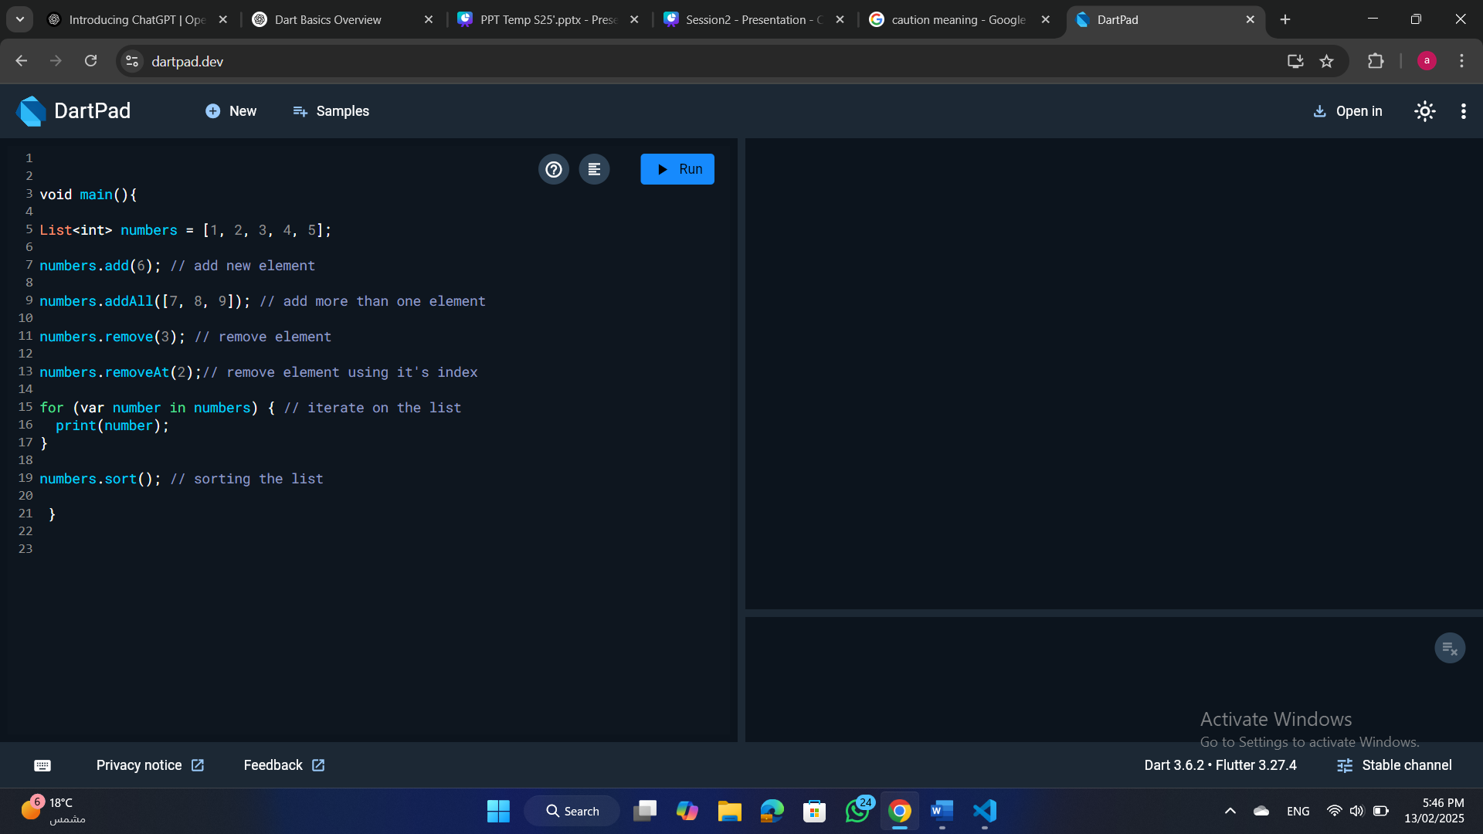
collections
List operations:
S25' Training Sessions

Slide 22
collections
Set:
A set is an unordered collection of unique items.
S25' Training Sessions

Slide 23
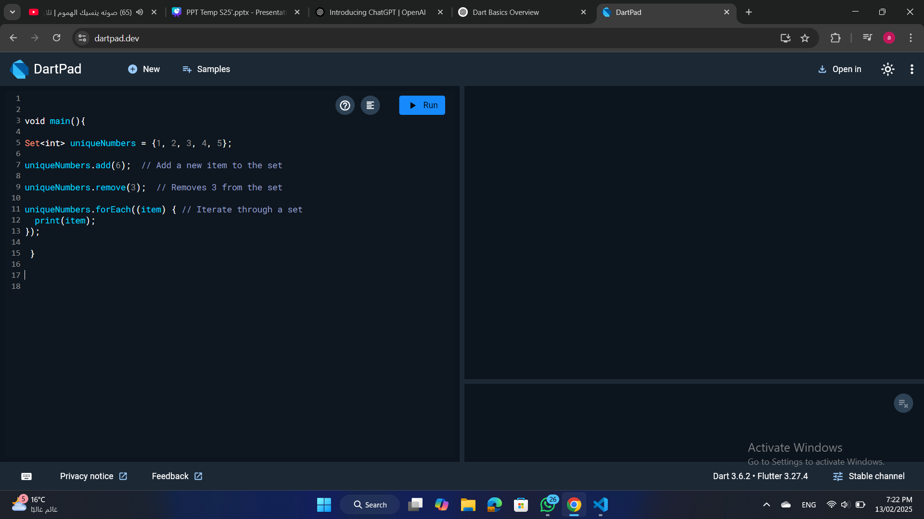
collections
Set operations:
S25' Training Sessions

Slide 24
collections
Map:
A map is a collection of key-value pairs.
S25' Training Sessions

Slide 25
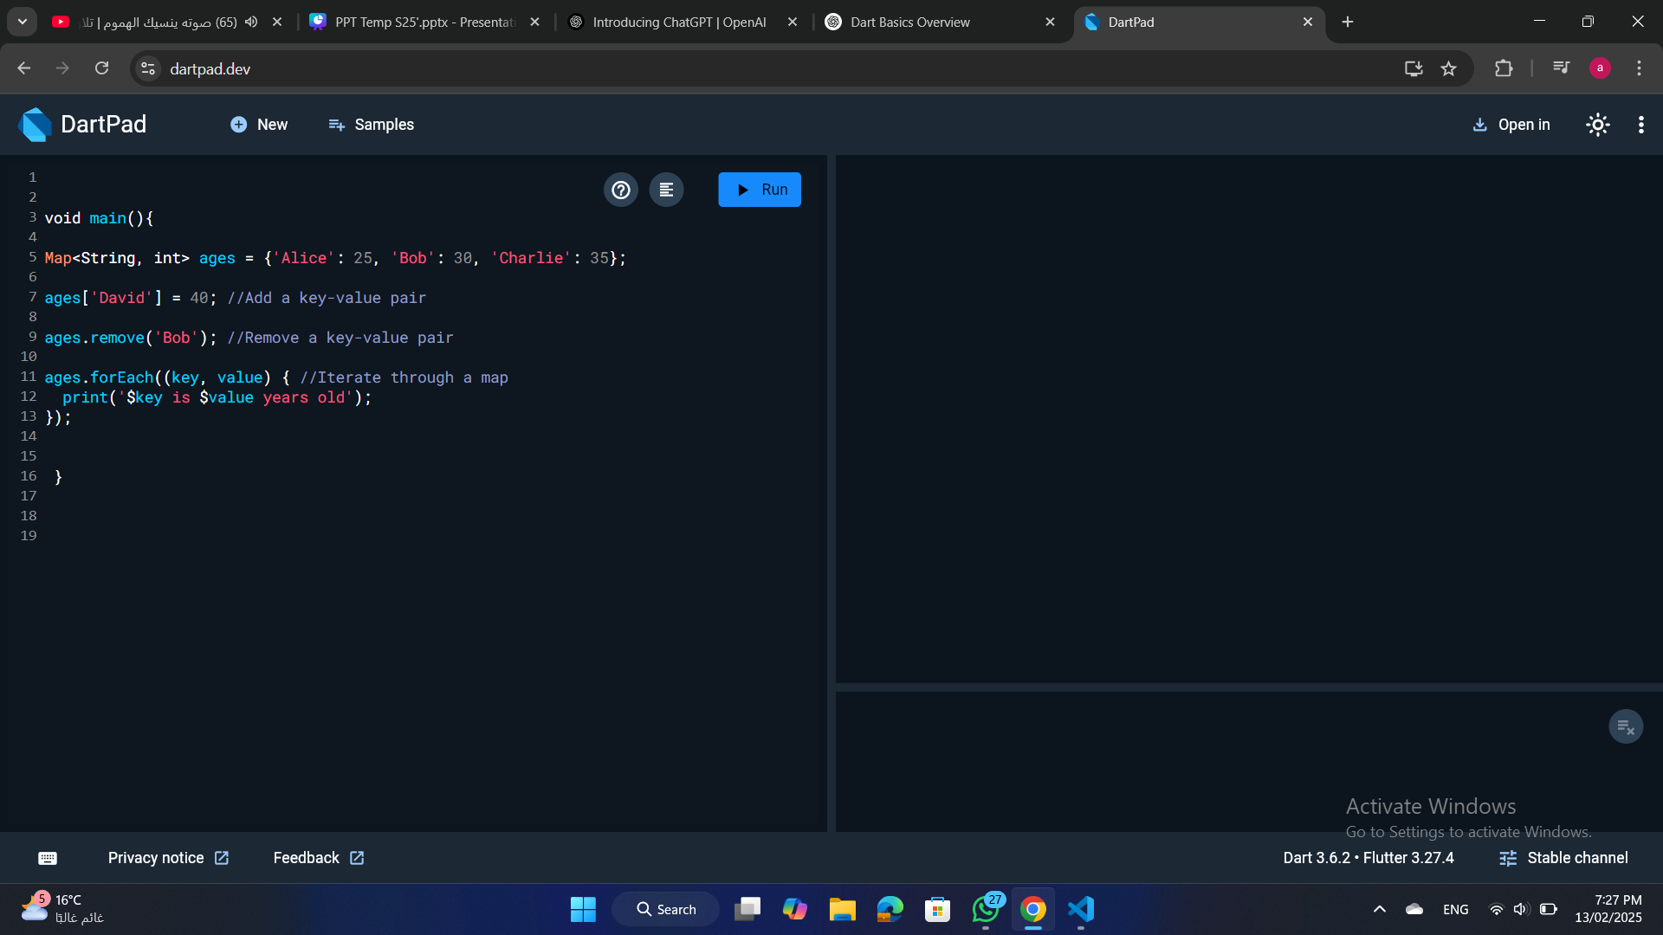
collections
Map operations:
S25' Training Sessions

Slide 26
Collection Method
Collection Methods :
S25' Training Sessions
In Dart, collections (such as List, Set, and Map) come with higher-order functions
that accept anonymous functions as parameters. These functions allow you to transform, filter, iterate, or reduce collections without writing explicit loops.

Slide 27
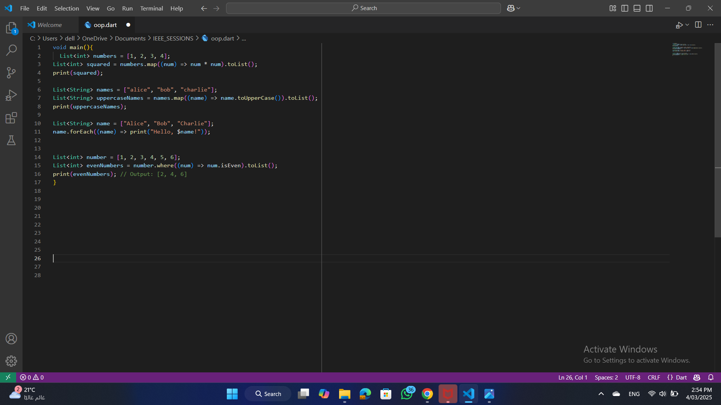
Collection Method
1.map() (Transform Elements)
The map() function applies a transformation to each element of the collection and returns a new iterable.
It does not modify the original list.
You must use .toList() or .toSet() if you need a concrete collection.
S25' Training Sessions

Slide 28
Collection Method
2. forEach() (Iterating Over Elements)
What It Does:
Executes a function for each element in the collection.
Unlike map(), it does not return a new collection.
S25' Training Sessions

Slide 29
Collection Method
3. where() (Filtering Elements)
What It Does:
Returns a new collection containing only the elements that match a condition.
Does not modify the original collection.
You must use .toList() or .toSet() if you need a concrete collection.
S25' Training Sessions

Slide 30
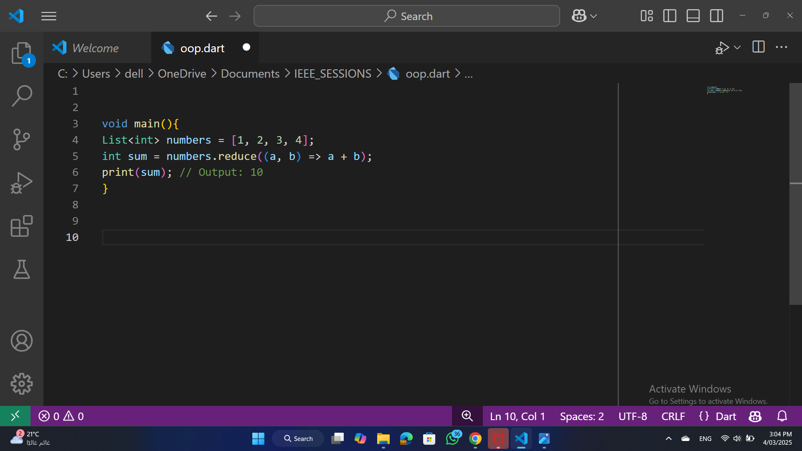
Collection Method
4.reduce() (Combining Elements into One Value)
What It Does:
Iterates over the collection and combines elements into a single result.
The function must take two arguments (previous result and current element).
If the collection is empty, it throws an error.
S25' Training Sessions

Slide 31
Exercise
Build a program to manage a supermarket inventory using a Map for items and their prices. Include functions to add, remove, and update items.
S25' Training Sessions

Slide 32
task
S25' Training Sessions
Refactor the supermarket program to include user input for dynamic inventory management

Slide 33

tHANK YOU
SEE YOU NEXT TIME
S25' Training Sessions

